Slide 1

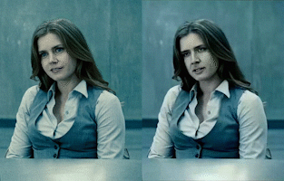
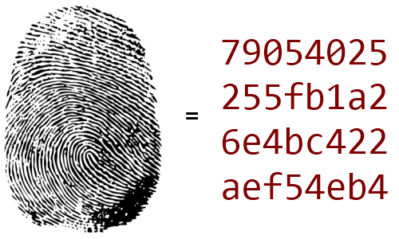
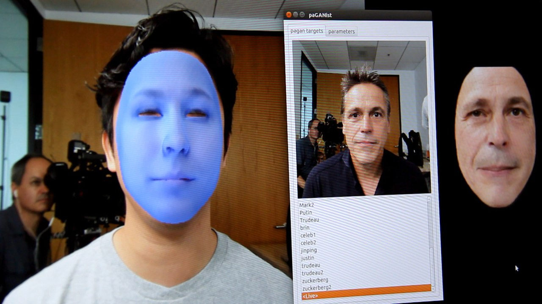



Face Hasher
Byran Beus and Henryk Sosnowski
Deepfake technology presents a security threat
Governments are still trying to find ways to detect these hoaxes
Our software allows the user to always privately record themselves and store encrypted records of their activities in a decentralized blockchain
Factom blockchain performs this activity for supply chain in a similar manner
Bitcoin is the predominant blockchain for decentralized storage

